Slide 1
Home Automation
201906100110032
Choksi Abhishek Premalkumar
Sem - 8
IT7029 - Internet of Things

Slide 2
Introduction
A home automation system that offers a variety of functionalities to help homeowners control their living spaces. This system is designed to be flexible, allowing users to control their appliances in a variety of ways, depending on their preferences and the type of appliance they are using.
One key feature of this system is real-time temperature monitoring, which helps to maintain a comfortable living environment by the fan on/off based on the temperature readings. This feature can also help to reduce energy consumption by ensuring that the fan is only used when needed.

Slide 3
Introduction (Continue...)
Another important aspect of this system is the ability to control appliances using IR remotes, WiFi, and manual switches. This allows users to control a wide range of appliances, from smart devices that are connected to the home network to traditional appliances that do not have smart features.
Overall, this home automation system is designed to offer a high level of convenience and flexibility, while also helping to improve energy efficiency and maintain a comfortable living environment.

Slide 4
Components
Node MCU ESP8266
4-channel 5V SPDT Relay Module
DHT11 Sensor
TSOP1838 IR Receiver
Switches or Pushbuttons
Any Color LED
220 OHM Register

Slide 5
Purpose
The purpose of this home automation system is to help homeowners create a more comfortable, energy-efficient living space while also streamlining the control of their appliances and devices. By automating routine tasks and providing greater control over energy usage, this system can make life easier for homeowners while also reducing their environmental impact.

Slide 6
How It’s Work
The home automation system works by connecting all the different devices in your home to a central hub or control panel. The hub is the brain of the system and is responsible for receiving inputs from various sensors and devices, processing them, and then triggering appropriate actions or responses.
In the case of the functionalities you have listed, here's how the home automation system would work:
Real-time temperature monitoring: Temperature sensors placed in each room send data to the central hub. The hub uses this data to determine whether the room temperature is within the desired range. If the temperature is too high or too low, the hub can turn on or off the fan accordingly, to adjust the room temperature.

Slide 7
How It’s Work (Continue...)
IR remote control: An IR blaster connected to the home automation system can mimic the signals sent by the IR remote for a specific appliance. When the user selects an appliance to control using the app or voice command, the hub sends the appropriate IR signal to the appliance, which responds accordingly.
WiFi control: Smart appliances that are connected to the home WiFi network can be controlled using an IoT app like Blynk. The app sends commands to the hub, which then forwards them to the appropriate device over WiFi. The device responds to the command and sends back data (e.g., the current temperature of a smart thermostat), which is then displayed in the app.
Manual switches: For traditional appliances that do not have smart features, manual switches or push buttons are connected to the hub or control panel. When the user presses the switch or button, the hub receives the input and sends a signal to the appropriate device to turn it on or off.

Slide 8
How It’s Work (Continue...)
Google Sheets integration: You can use Google Sheets to store data collected by the home automation system, such as room temperature, energy consumption, and appliance usage. To do this, you can use the Google Sheets API to create a connection between the home automation system and a specific Google Sheet.
Firebase integration: Firebase is a cloud-based platform that allows you to store and sync data in real-time across multiple devices. You can use Firebase to store live data collected by the home automation system, such as temperature, humidity, and energy consumption.
Firebase also provides tools for data analysis and visualization, allowing you to create real-time dashboards and reports to monitor your home automation system. This can be especially useful for tracking energy usage and identifying areas where you can reduce your consumption.

Slide 9
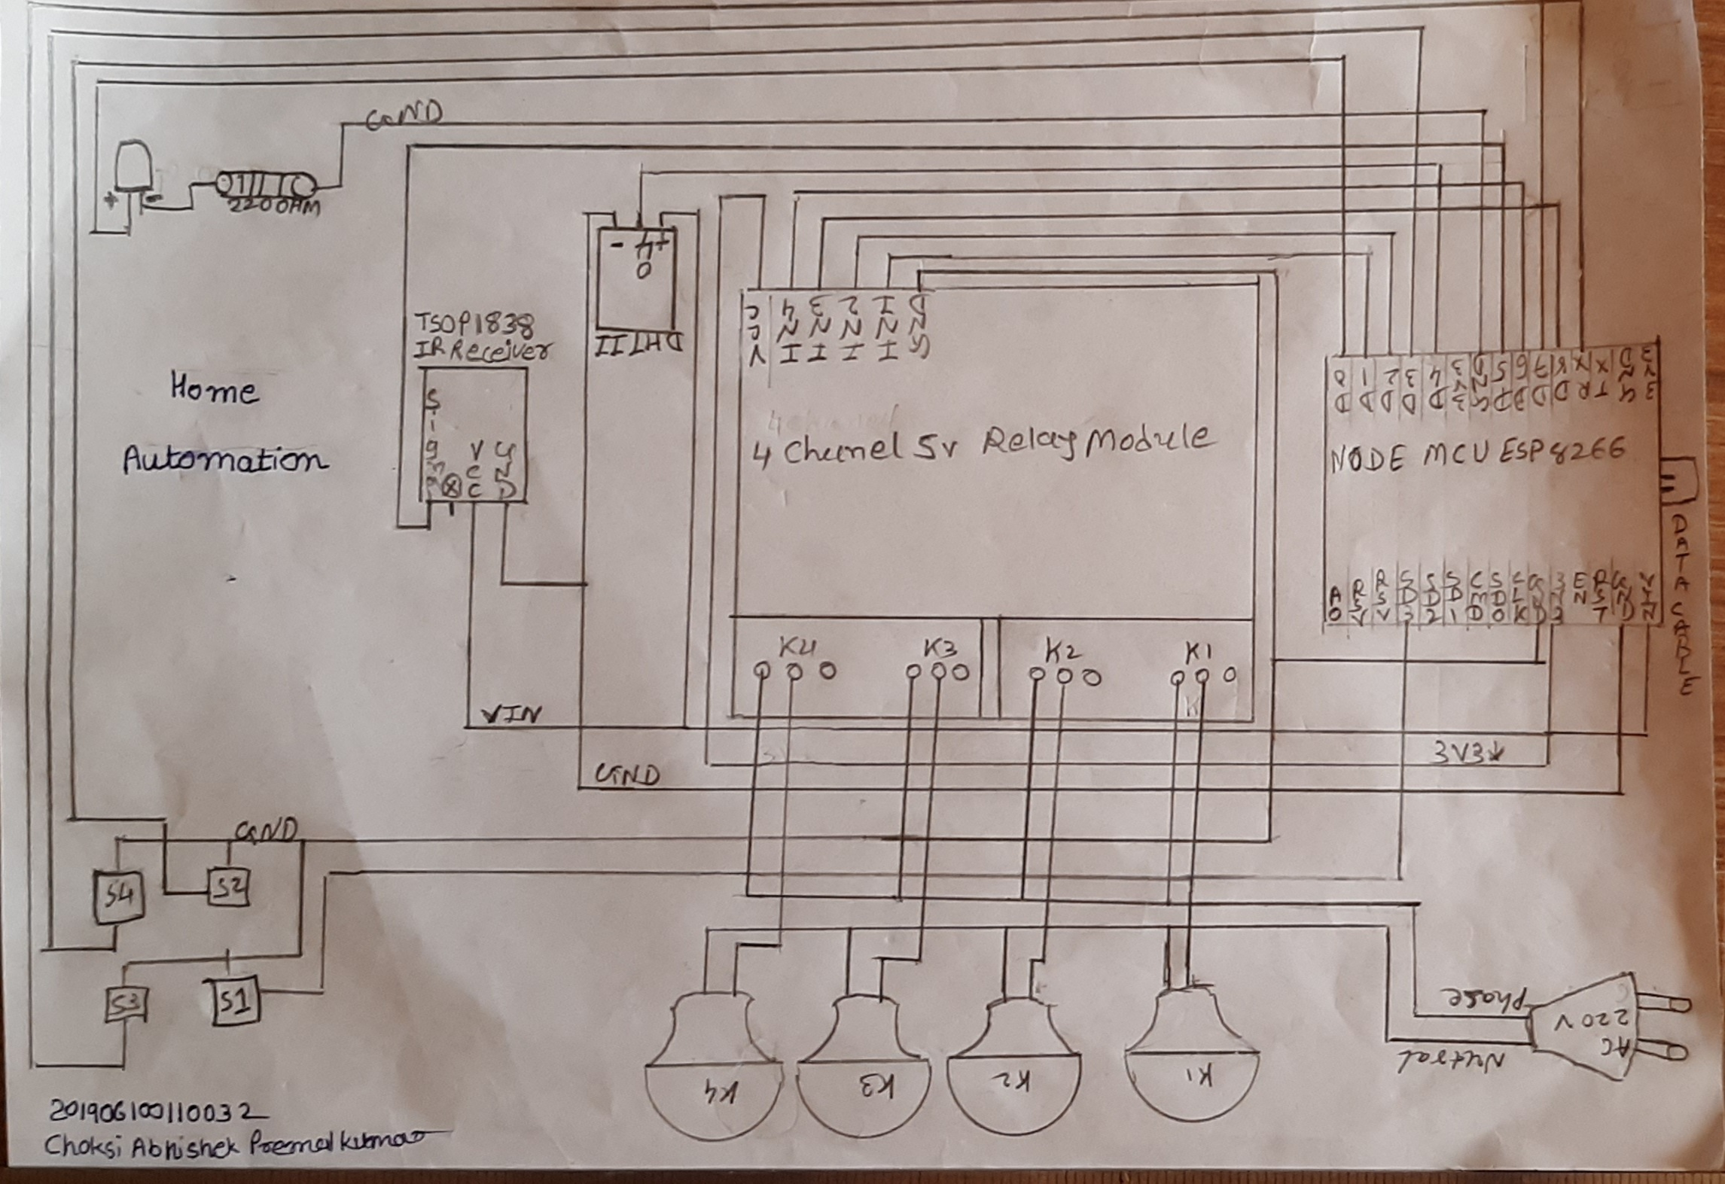
circuit diagram

Slide 10
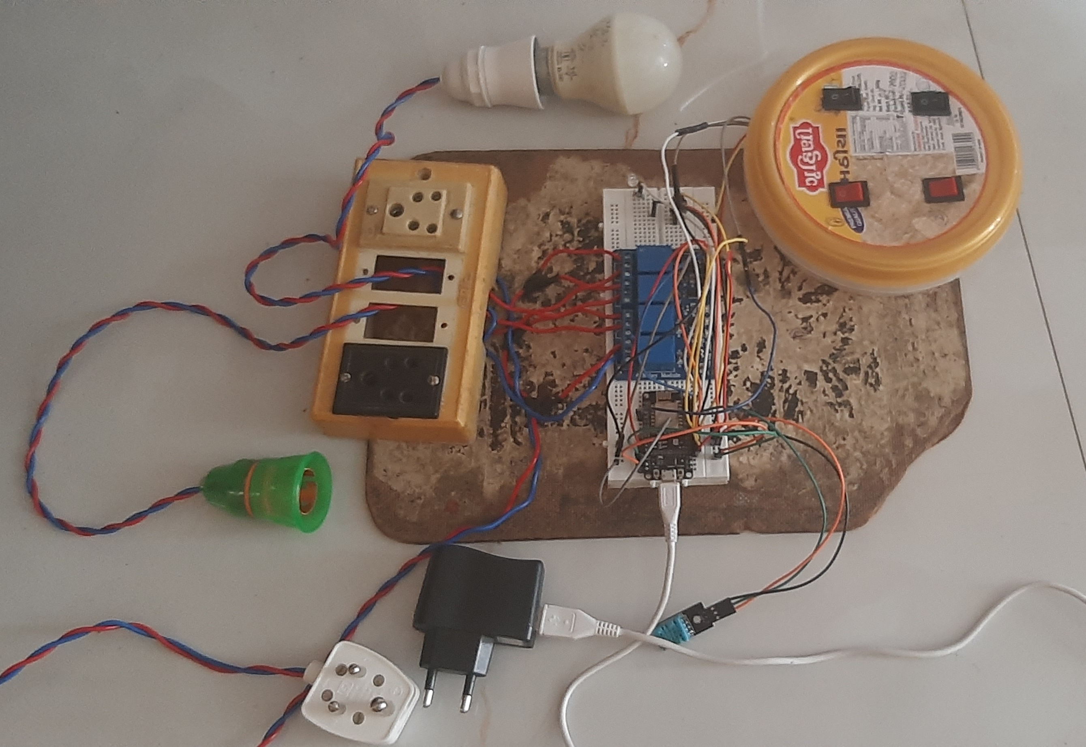
Picture - 1

Slide 11
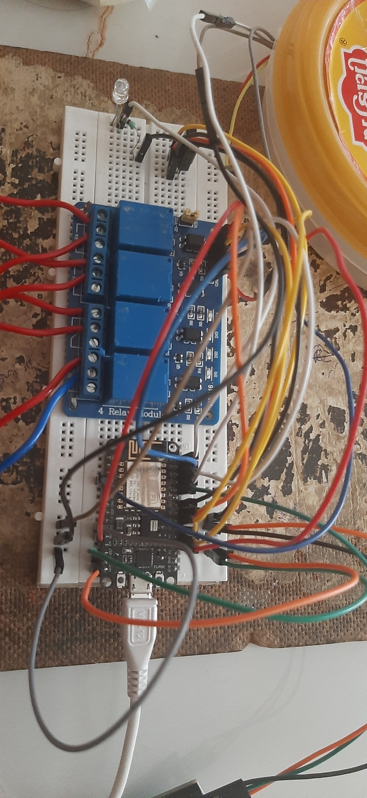
Picture - 2

Slide 12
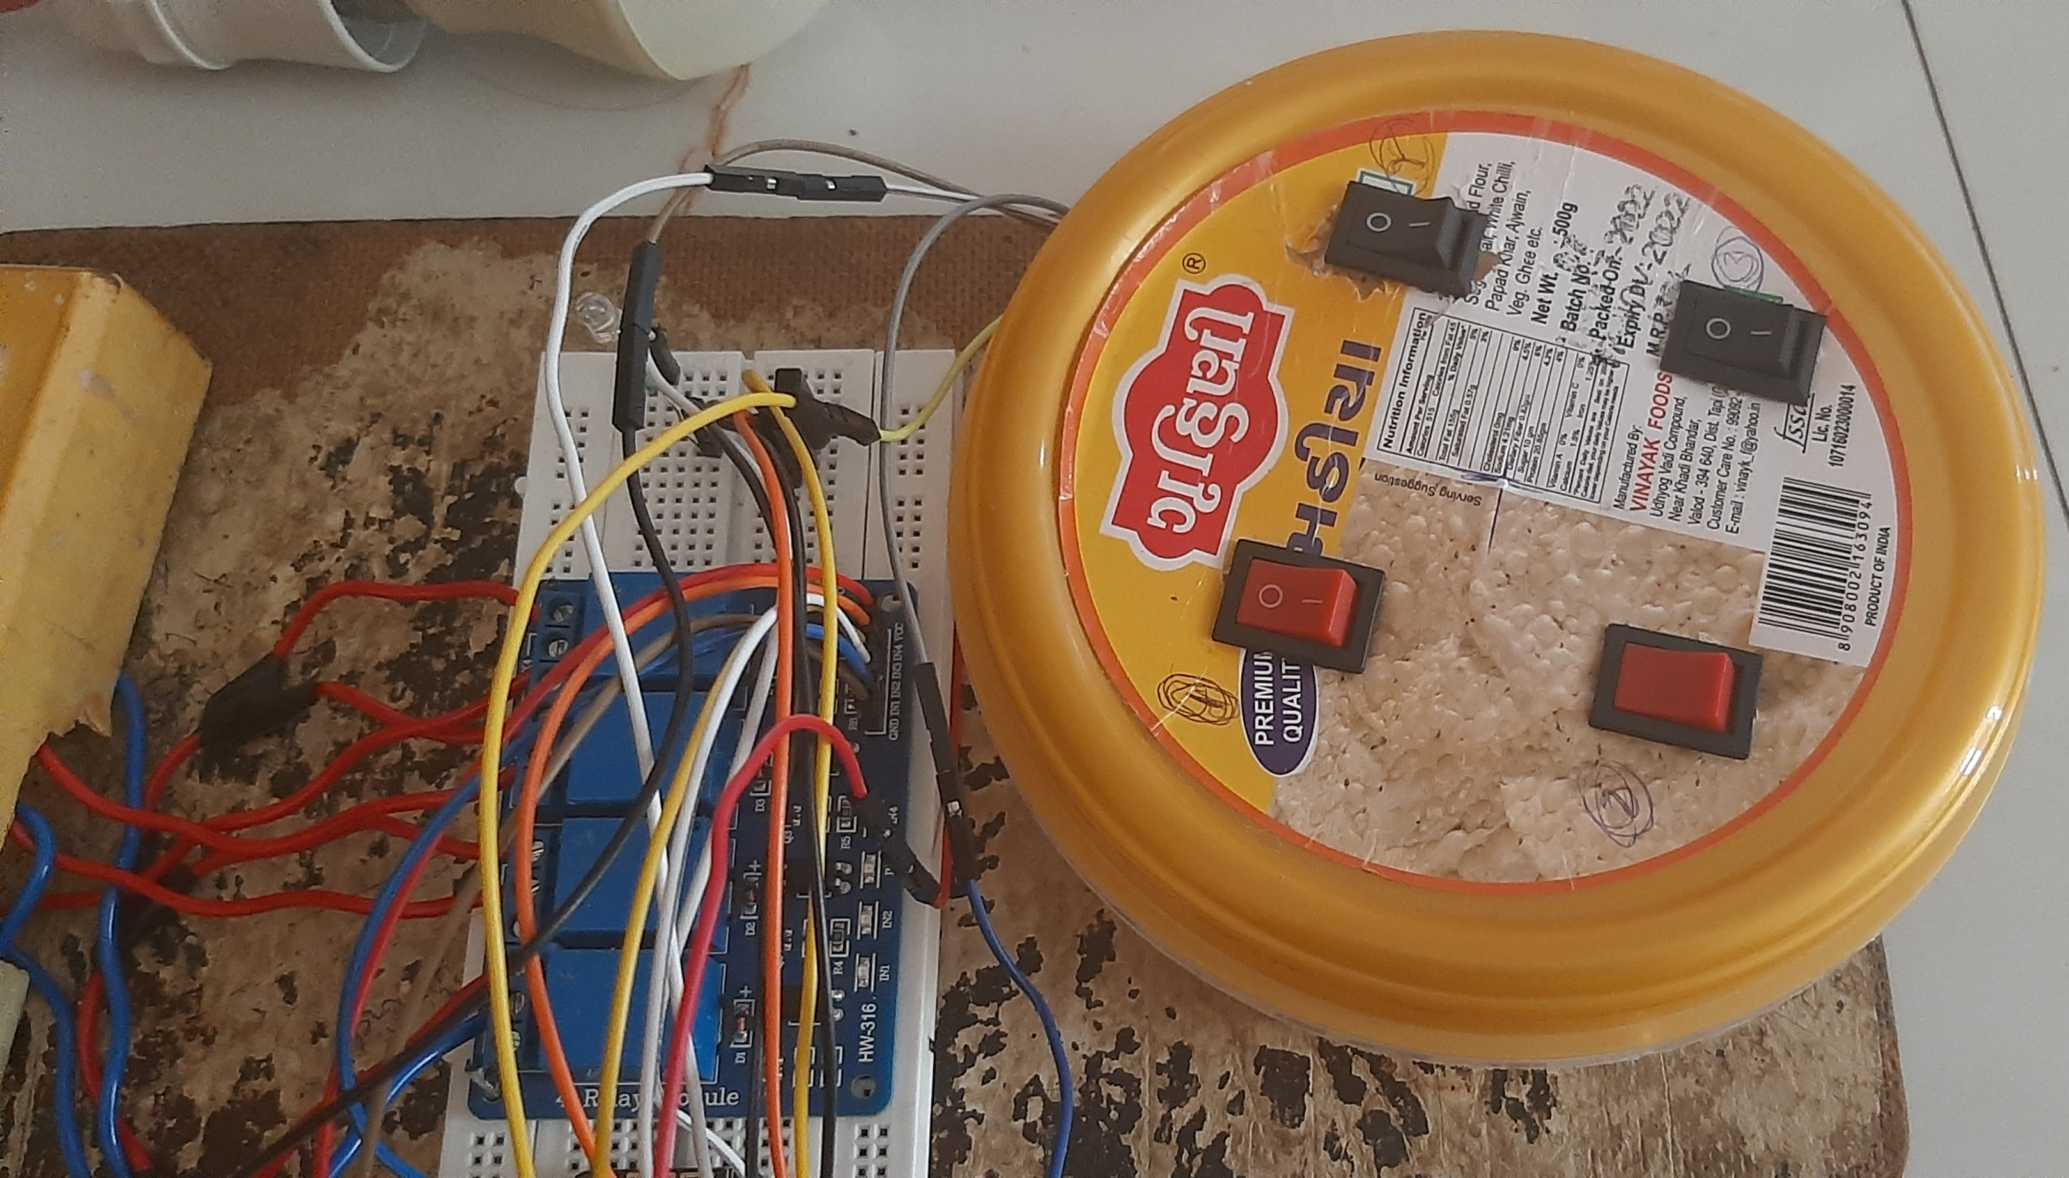
Picture - 3

Slide 13
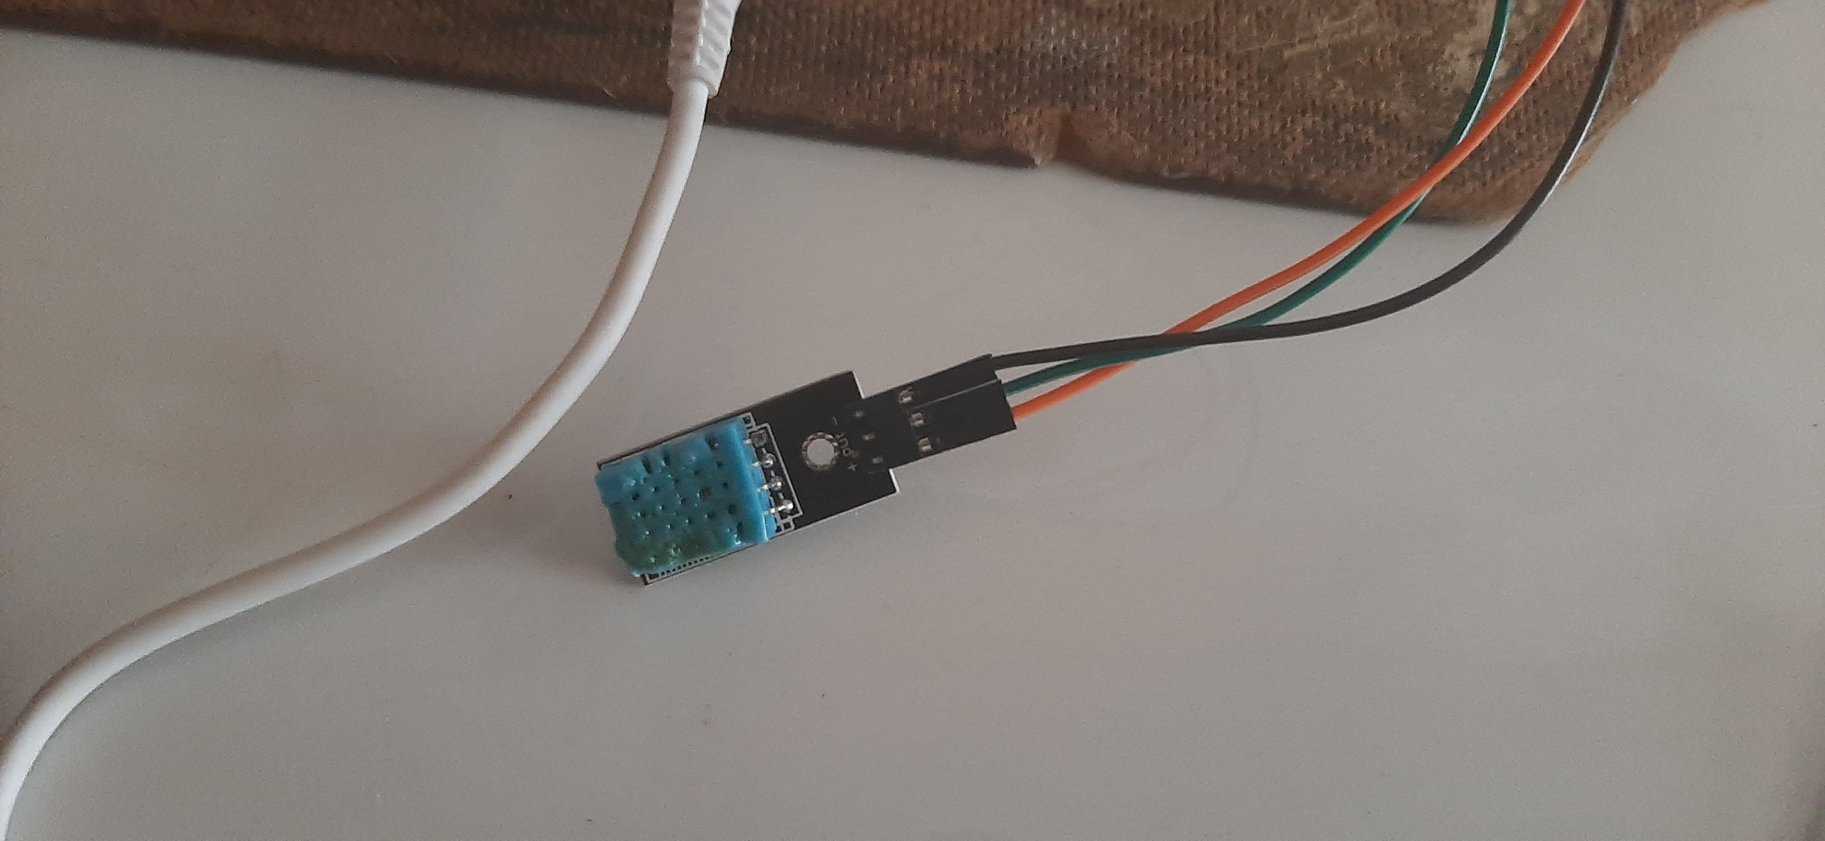
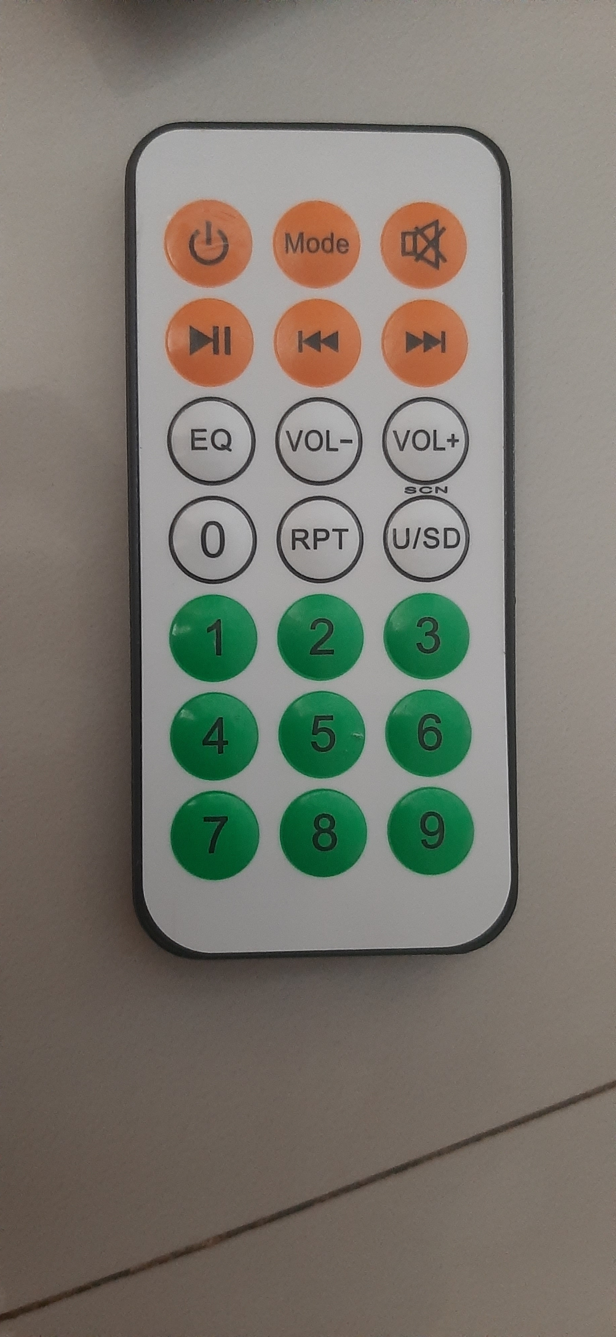
Picture - 4

Slide 14


